Slide 1

Glamping

Slide 2
Glamping Business
Design, Development, Planning & Financials
Hospitality . Wellness . Lifestyle
Middle East
2405, HDS Tower, Jumeirah Lake Towers
Dubai, United Arab Emirates
Ph: +971 04 4534976
Email: ag@5sensiconcept.com
Singapore
10 Anson Road, 18- 11
International Plaza, Singapore 079903
Email: ds@5sensiconcept.com
Ph: +68 9800 2165
Web: www.5sensiconcept.com
Europe
264, Main Street
Mallieha, Malta
MLH 2317079903

Slide 3
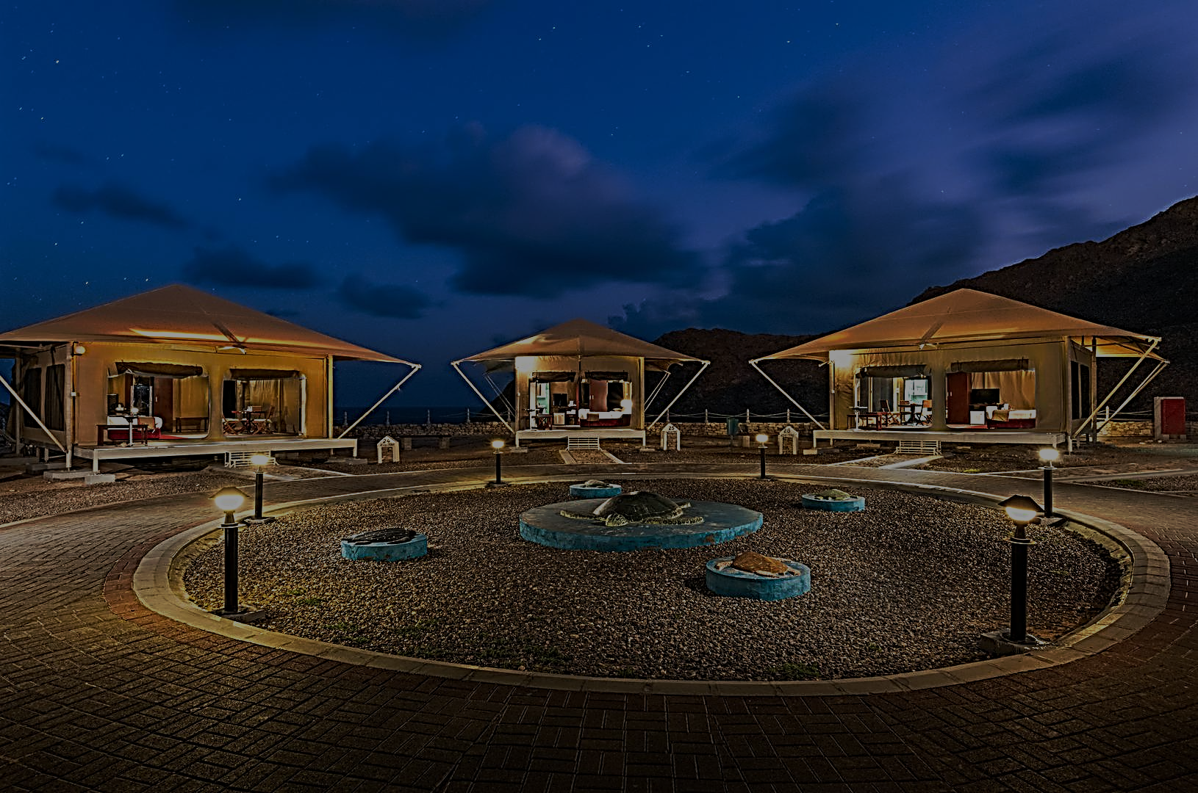
Index:
Introduction
Why Glamping?
Business Models
Business/ Project Pre-requisites
Feasibility Study
  Typical Project phase timelines
  Financial P&L
  VSENSI Glamping Advantage

Slide 4
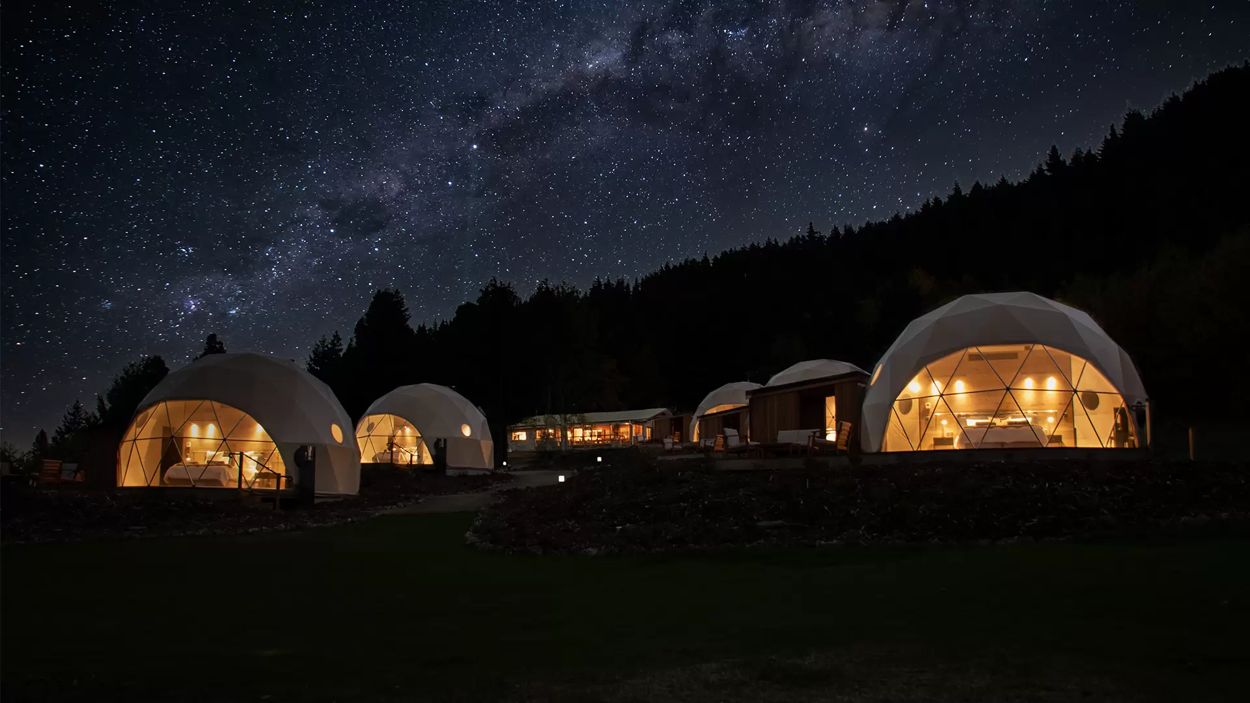
Introduction
“Glamping,” short for glamorous camping, has become a mainstay of outdoor recreation over the past decade. If your essentials list contains things such as a real mattress, running water or an actual toilet, you can still find numerous options that bridge the gap between traditional camping and the comforts of home.
Glamping is one of the best environmentally-friendly and sustainable travel experiences. It combines all the benefits of camping with the comfort and luxuries of an up-market hotel.
Typically, glamping means sleeping in a tent, but a souped-up tent like none you've ever seen before, with a floor, rugs, beds, comforters, chairs, and in many cases heat, electricity, and running water. Your tent may have its own bathroom, but if it doesn't, a shared facility will be a short walk away.

Slide 5
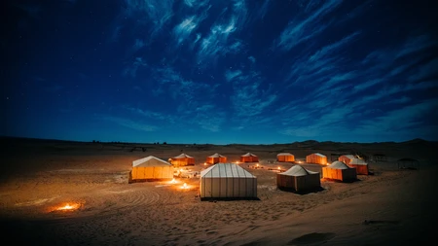
Why Glamping?
1. Exercise
It’s recommended that people get et at least 150 minutes of moderate aerobic exercise a week. During a glamping break, you’ll easy hit that target! Walking on the beach, playing with the dog and exploring the local countryside all counts towards your quota, and you’ll be having so much fun that you probably won’t even realize it!
3. New experiences
They say a change is as good as a rest, and there are plenty of new experiences to try while glamping. From experimenting with recipes over the fire to sleeping under canvas, or even something to get the heart pumping, such as surfing or climbing, there’s plenty of opportunity to try something new during your holiday.
5. Good night’s sleep
How many of us can say we regularly get a good night’s sleep? Research has shown time and time again that a natural sleeping pattern gives you a much better quality of sleep. A glamping break is a great way to find that pattern; the early morning sunshine and slow sunsets both act as ques for the body to wake up or wind down. Finding a natural sleeping pattern can take as little as three nights. Combined with all that fresh air and exercise, you’ll be nodding off in no time!
6. Beating stress
The sound of the wind through the trees, birds singing, a babbling brook… not to mention the chance to drink in nature or simply sit in the sun with a good book! Glamping is a fantastic way to escape the stress and chaos of modern life. Switch off your phone, sit back and feel yourself relax.
2. Clean Air
Fresh air has been shown to boost your immune system, give you energy and improve your lung and brain health… not to mention give you a surge of endorphins, known as the happy hormones!, so it’s no effort at all to get out there and take a deep breath of clean, fresh air.
4. Lots to learn
Don’t tell the kids, but glamping can actually be a very educational experience. From learning about the trees and foliage of your surroundings, to exploring different parts of the country, you’ll find plenty of chances to learn.

Slide 6

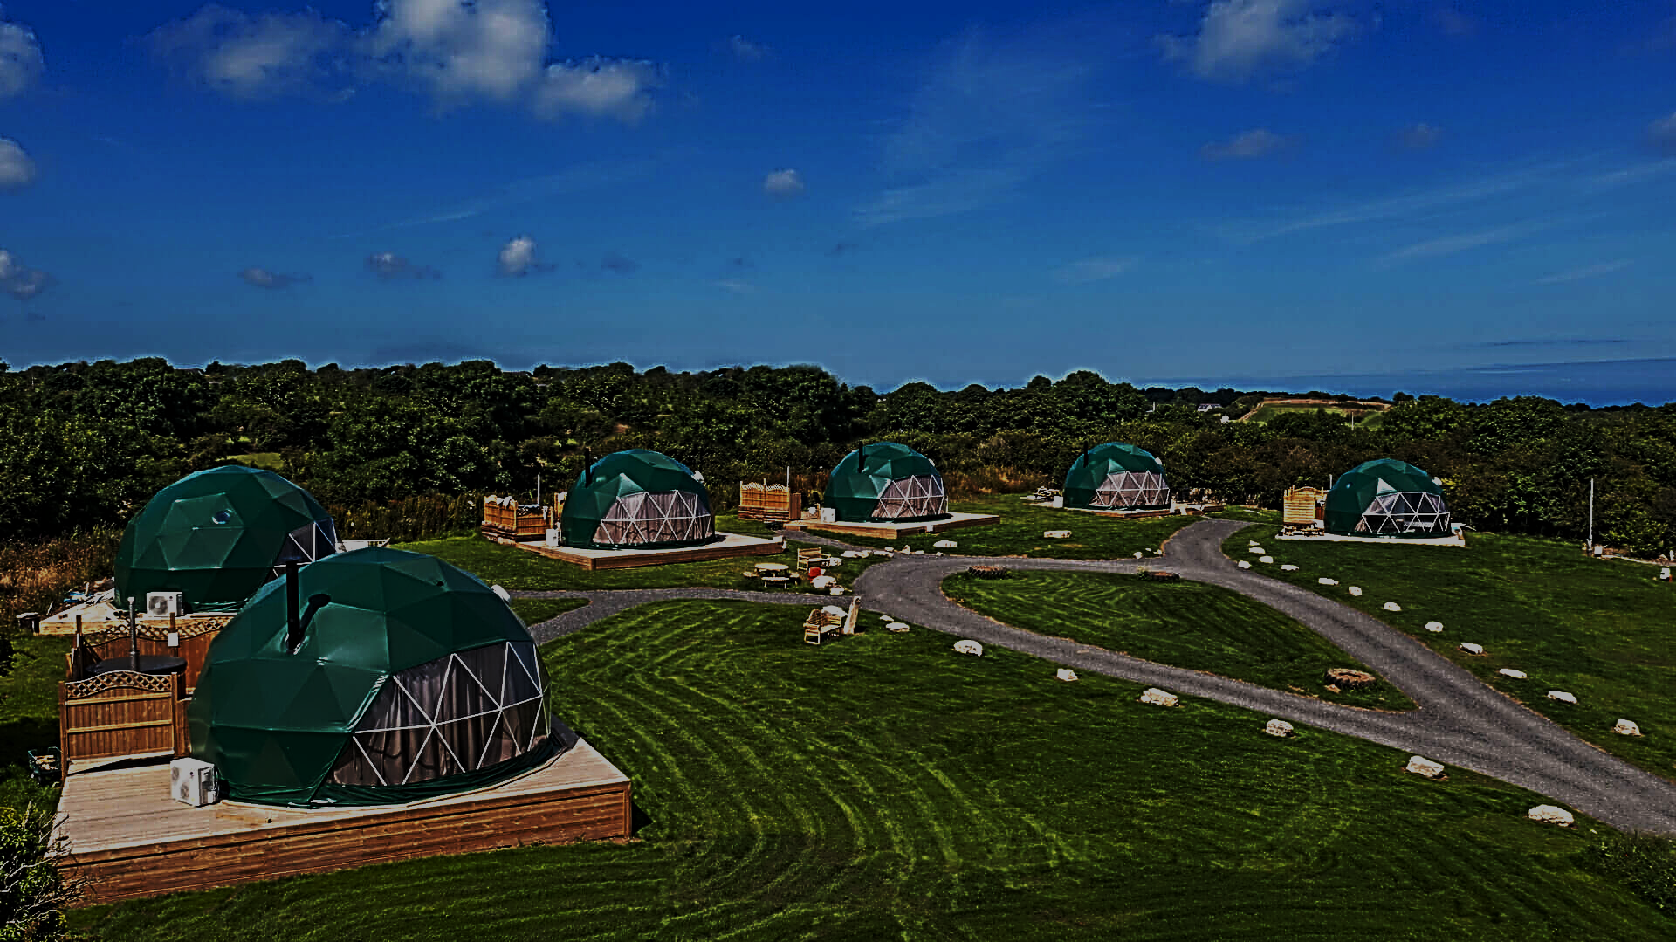
7. Boost your mood
Many studies have suggested that spending time outside can boost your mood, even helping combat signs of depression. In fact, a holiday in the fresh air has been shown to give you a mental boost for up to two weeks!
9. Great food
After a long day exploring, you’re sure to build up quite an appetite! A glamping break is the perfect opportunity to try cooking something new – make sure to take a look at our healthy and veggie firepit recipes! Of course, you’ll deserve a few treats during your holiday, so make sure to pack some marshmallows and other treats to toast over the flames.
8. Beautiful surroundings
There’s a great deal to be said for simply sitting back and enjoying the beauty of nature. Whether it’s the dramatic cliffs of Cornwall or the picture-perfect Suffolk countryside, there’s so much to discover around our sites. The more you look, the more you see, and getting out and about will leave you feeling relaxed and appreciative of the beauty all around you.
10. Amazing company
The most important part of any break is spending some quality time with the people you love. With no distractions, just the great outdoors and your cosy tent, you’ll have the perfect time to sit down and make some memories. From games in the forest to bedtime stories around the fire, it’s a magical way to reconnect with those closest to you.

Slide 7
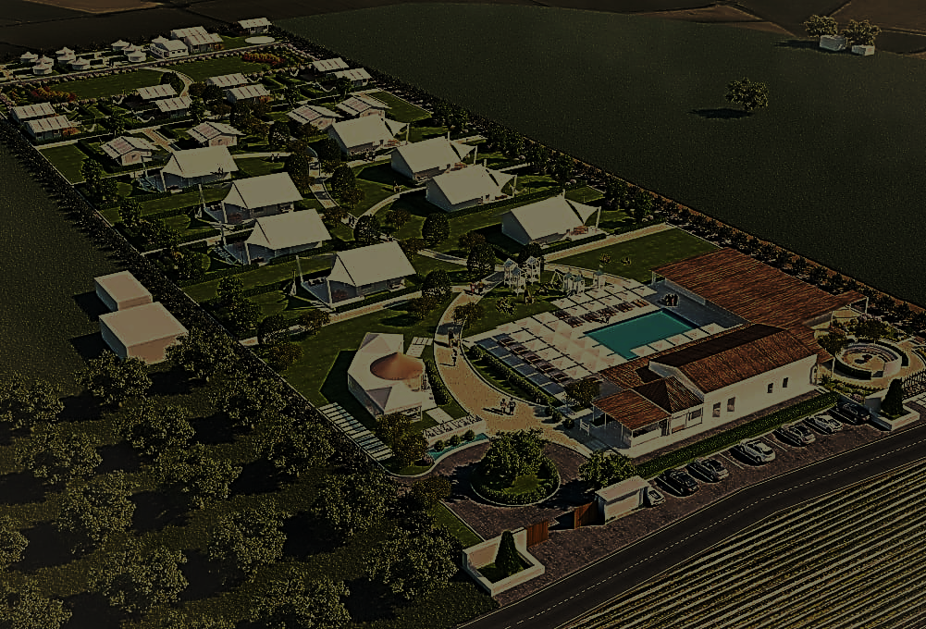
Business Models:
Model 1
Own land and Bank project loan
Here the land value can be leveraged to get a full project loan
The entire project can be of the owner without any other business share
Model 2:
Leased land and bank project loan
Here we pay a rent on the land lease to landowner.
We need to invest at least 30% of the total project cost
The rest of the project cost can be taken from a Bank/ financial institution
Model 3:
Owner’s land with project loan, no rent but profit sharing (Landowner is a partner)
Here the land value can be made as collateral to gain the full project loan
Landowner becomes a partner in the business and receives a proportionate profits from the business
Model 4:
Leased land and PE and proportionate profit sharing
Here we pay a rent to the landowner
A PE invests along with us on the project
PE receives proportionate share of the profits

Slide 8
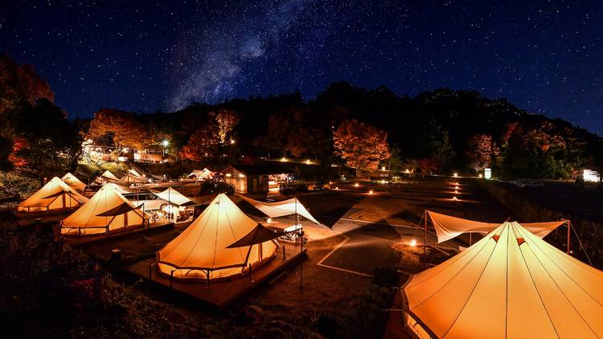
  Project Pre-Requisites:
Executive Summary
Overview of concept and business
Site and surrounding location
Access
How the glamping business will operate
Layout
Scale
Landscaping
Build phases
Local Municipality Application for all permissions
summary

Slide 9
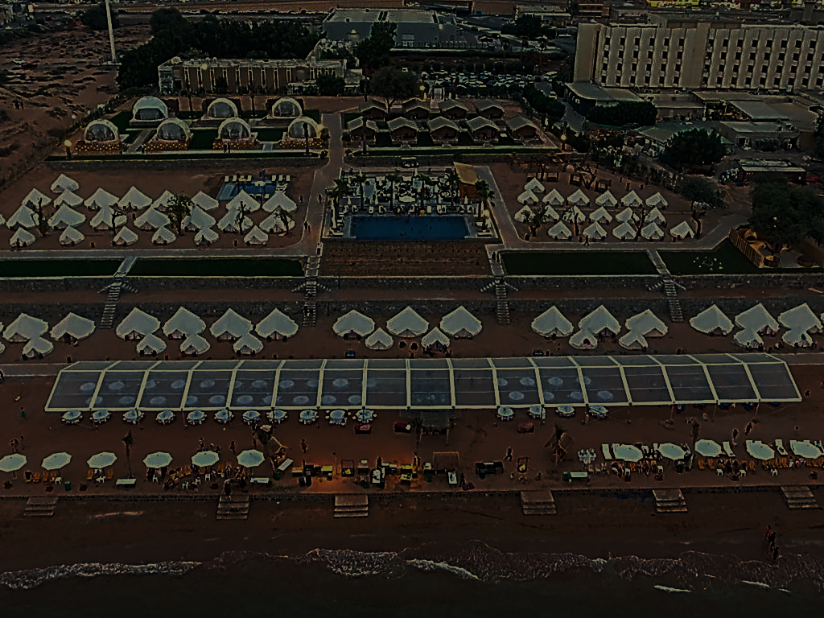
  Project Feasibility:
  Market Research - Tourism Demand Analysis, target markets & sources, existing local accommodation & competition analysis
  Land Topography & soil testing
  Glamping layout & technical drawings/ renderings
  Infrastructure Drawings (Mechanical, Electrical, Lighting, Plumbing, Telecom, Air-conditioning, Landscaping)
  Development costs – Architects, Statutory Consultants, Tent, Interior, labor, transportation, Working Capital
  Traffic & Parking
  Ecology & Habitat assessment
  Local Govt. permissions
  Financial plans & projections

Slide 10
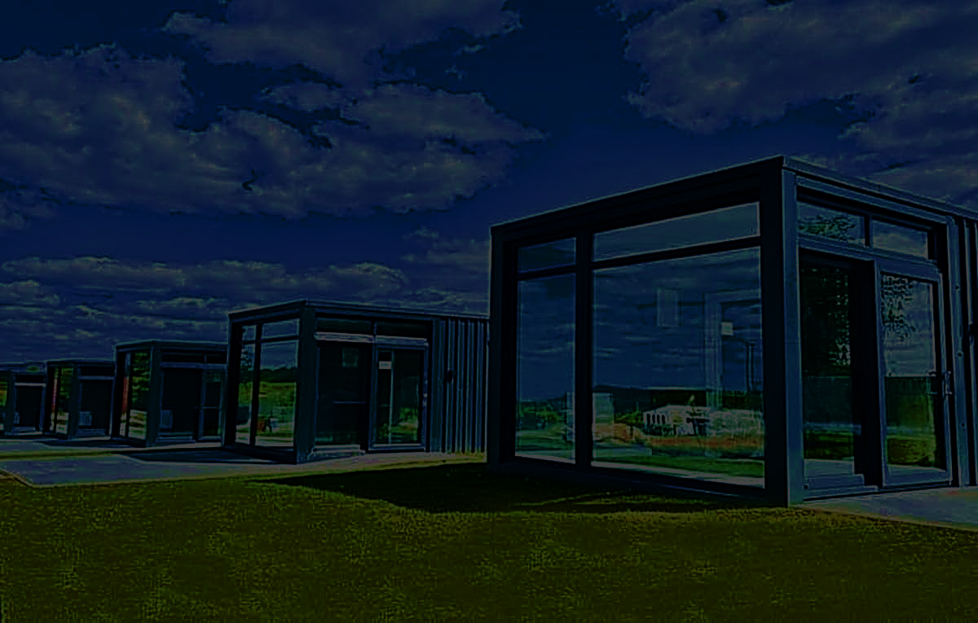
  Typical Project phase timelines:
Typical Project phase timelines:
Find Land
Feasibility Study
Choose Tent
Build Site
Open for Business
1
2
3
4
5
6
7
8
9
Project
pre-planning
Project Site Design & Finance
Local Permissions
Marketing & Sales process
Typically, 30 to 60 days

Slide 11
  Typical Project Financials
INCOME | Assumptions | Year 1 | Year 2 | Year 3 | Year 4 | Year 5
No.of tents/year |  | 3650 | 3650 | 3650 | 3650 | 3650
Occupancy (%) |  | 50 | 60 | 70 | 80 | 80
No.of tents sold |  | 1825 | 2190 | 2555 | 2920 | 2920
Average rate/day |  | 150 | 170 | 190 | 210 | 230
Tent revenues |  | 273,750 | 372,300 | 485,450 | 613,200 | 671,600
F&B revenues | 20% of room revenues | 54,750 | 74,460 | 97,090 | 122,640 | 134,320
Other revenues | 5% of room revenues | 13,688 | 18,615 | 24,273 | 30,660 | 33,580
Total Revenues |  | 342,188 | 465,375 | 606,813 | 766,500 | 839,500
Assumptions | Amount (US$)
No. of Tents | 10
Project area (sq.m) | 3,000
Cost of Tents (US$/tent) with installation | 2,000
Total cost of Tents | 20,000
Cost of Tent Interior(US$/ tent) | 3,000
Total cost of interior | 30,000
Cost of bathroom/tent | 1,000
Total cost of bathrooms | 10,000
Infrastucture & landscape cost (US$/sq.m) | 10
Total Infrastucture cost | 30,000
Cost of tent decking (US$ 750/tent) | 7,500
Cost of Govt. permissions (lump sum in US$) | 10,000
Initial Working Capital | 50,000
Misc. expenses | 10,000
Total cost of project | 167,500

Slide 12
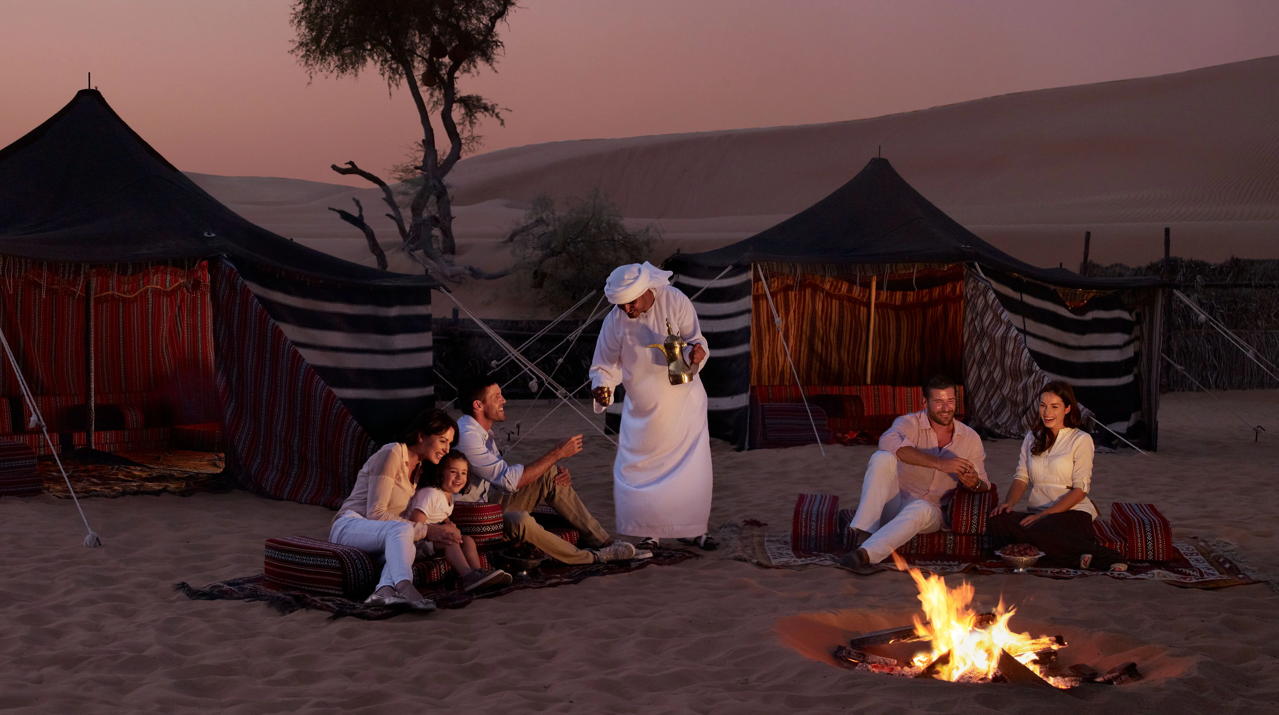
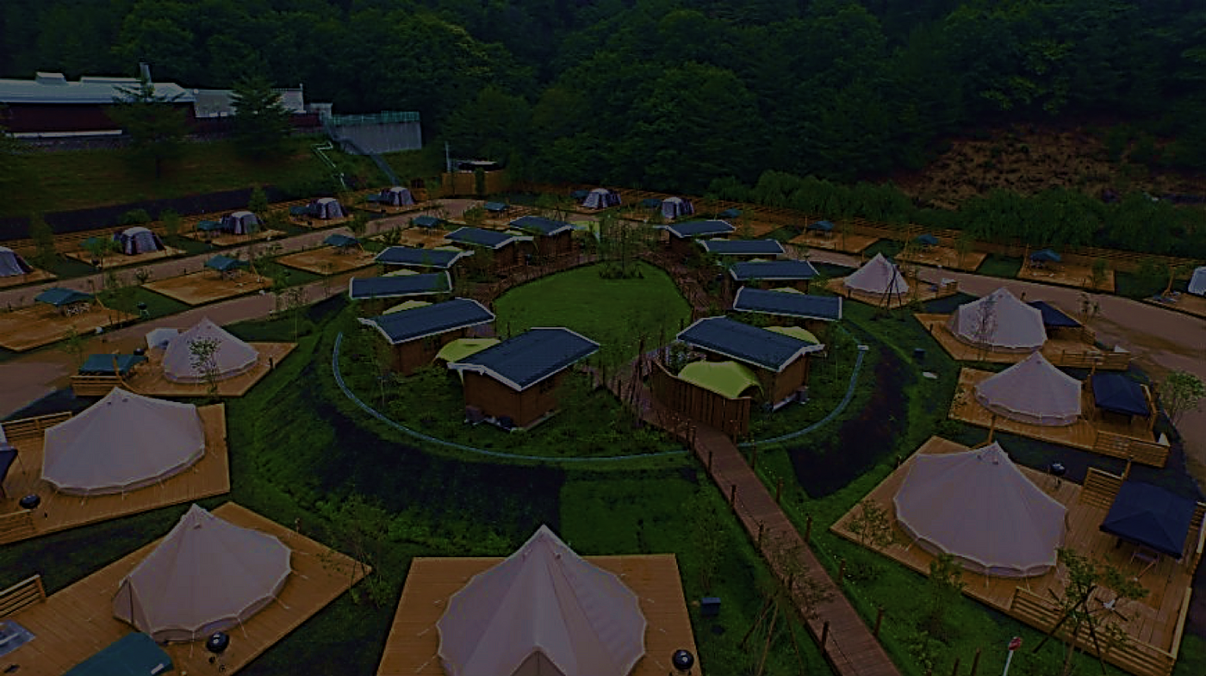
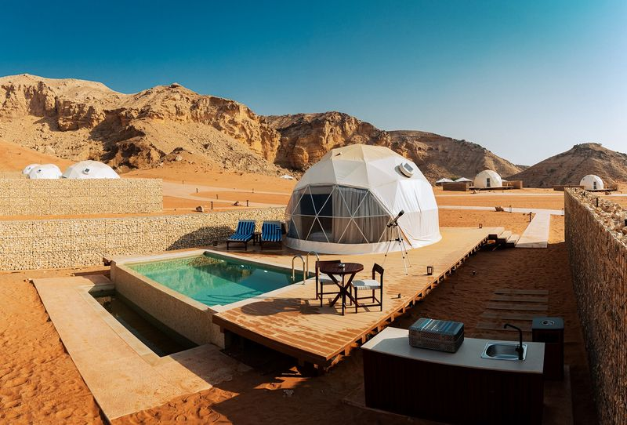
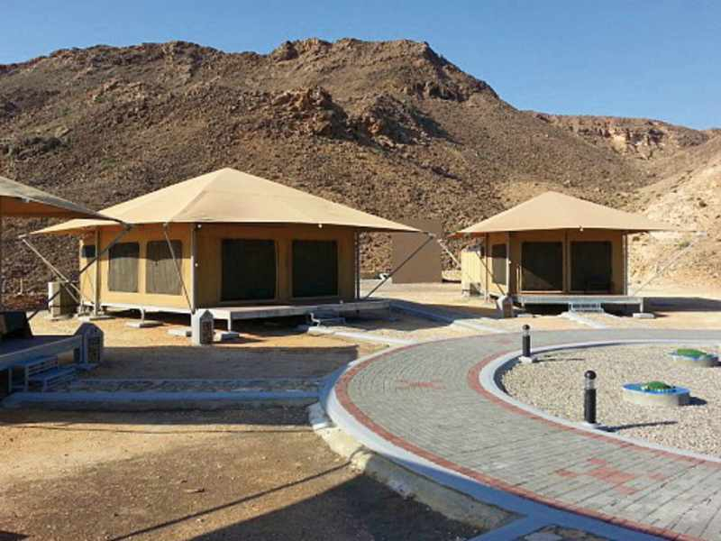
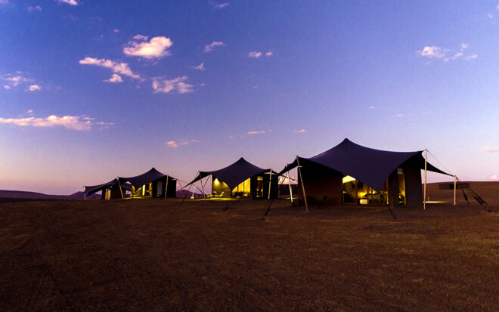
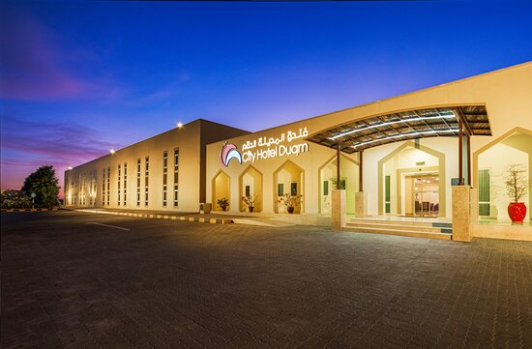
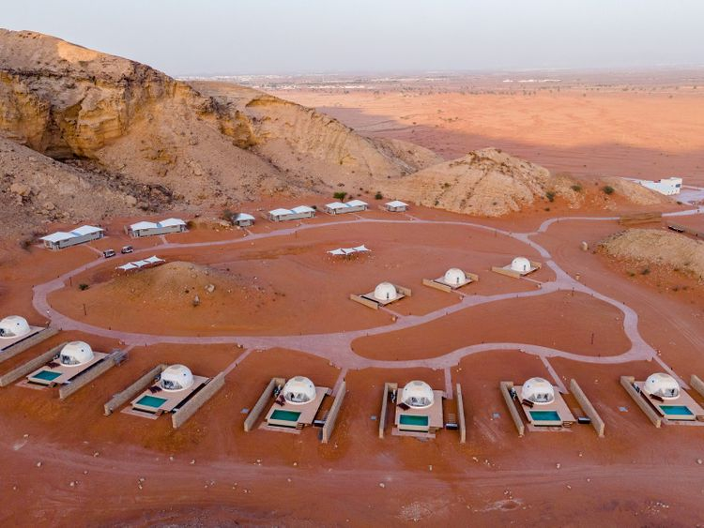
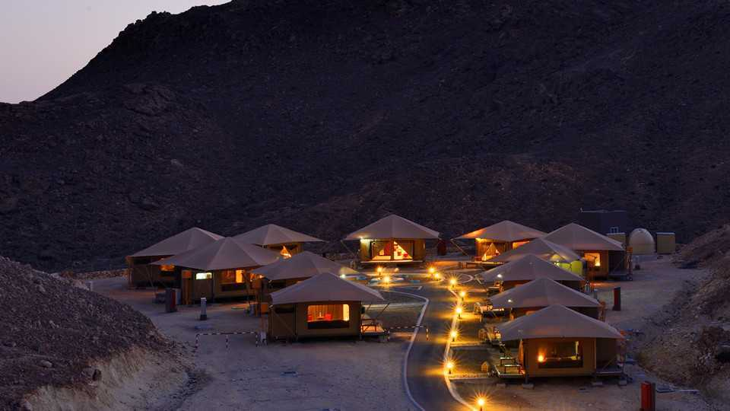
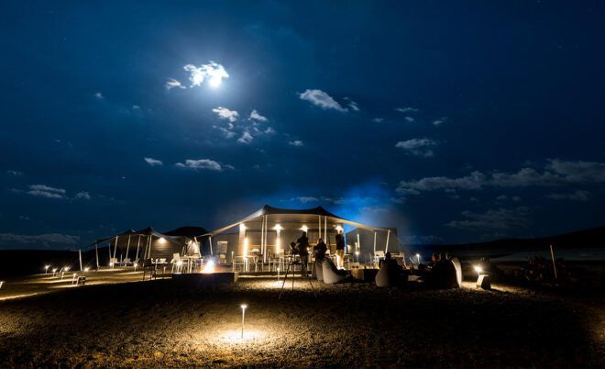
The VSENSI Glamping Project experience:
Mysk Moon Retreat, Sharjah, UAE
Ras Al Jinz Turtle Reserve, Oman
Khaybar Harrat, Saudi Arabia
Pre-fabricated Hotel, Duqm, Oman

Slide 13
The VSENSI Glamping Advantage
We have years of progressive and deep project experience with Glamping business
We understand no two projects are the same due to location, country, markets, visitor source and variations in project costs.
We understand not all glamping tents are suitable for all sites and need tailor-made solutions.
Our industry connections enable us to give informed advice on future unit purchases.
We do the whole process from finance to development to profitable operations.

Slide 14
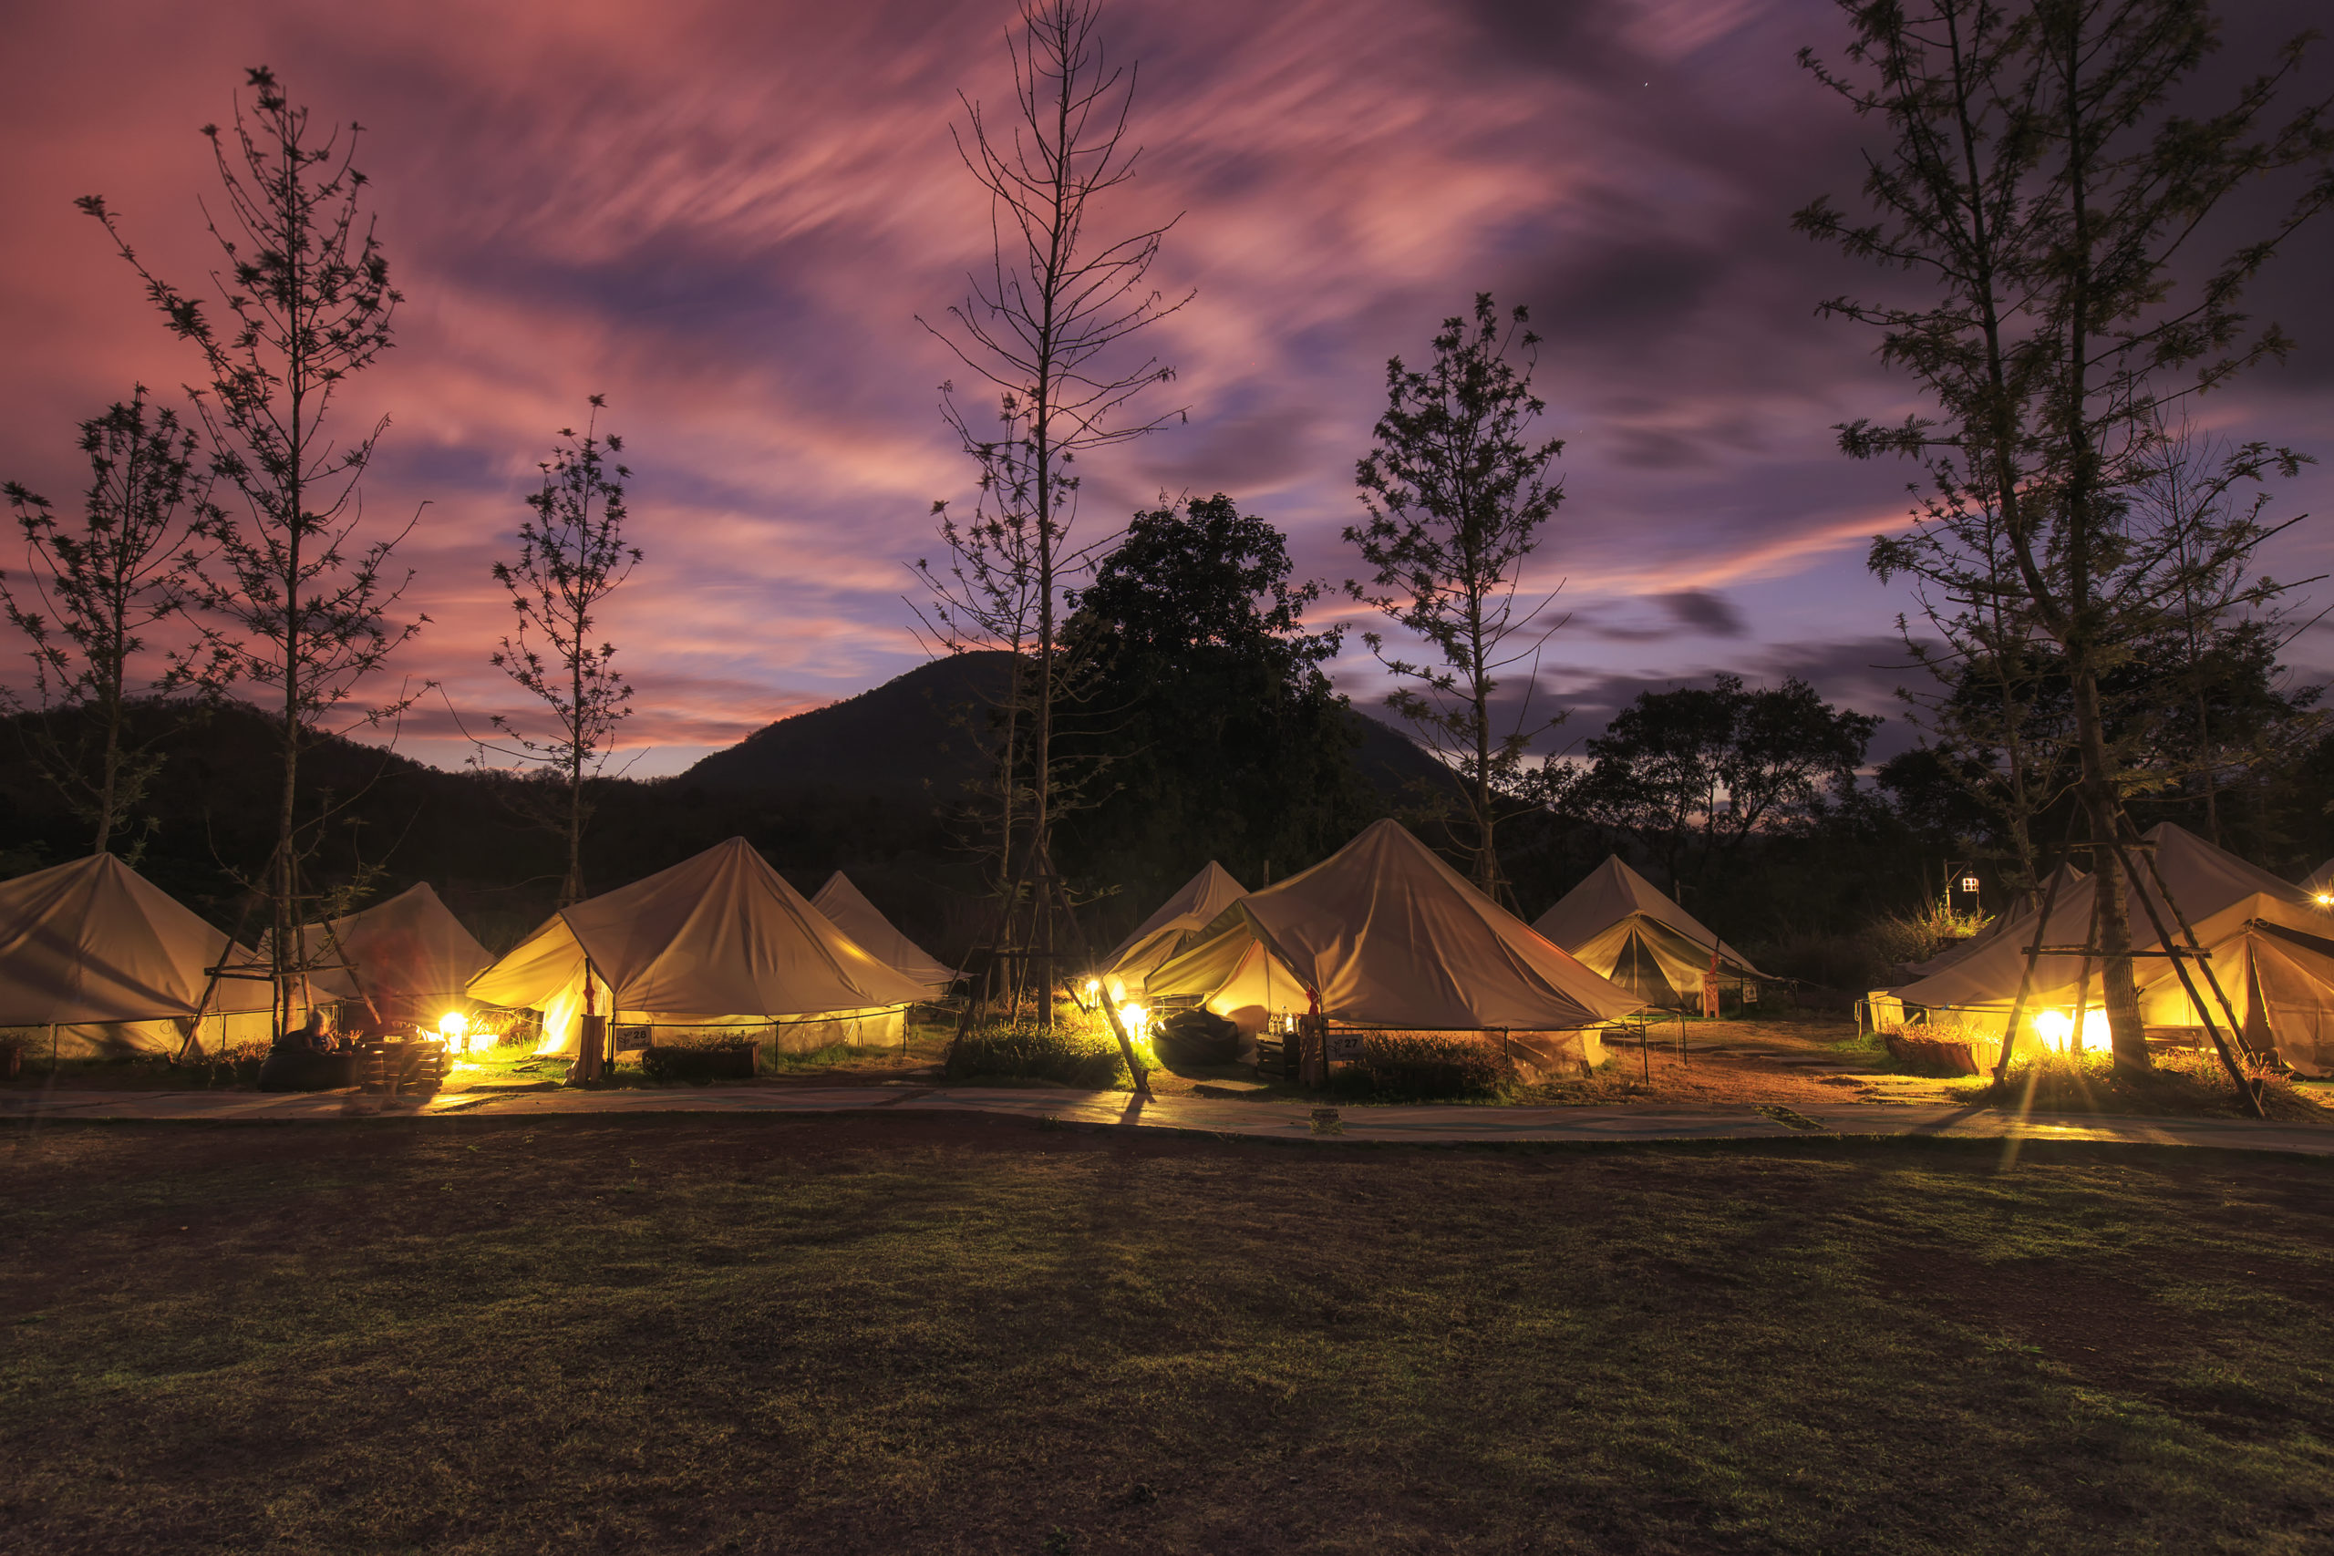
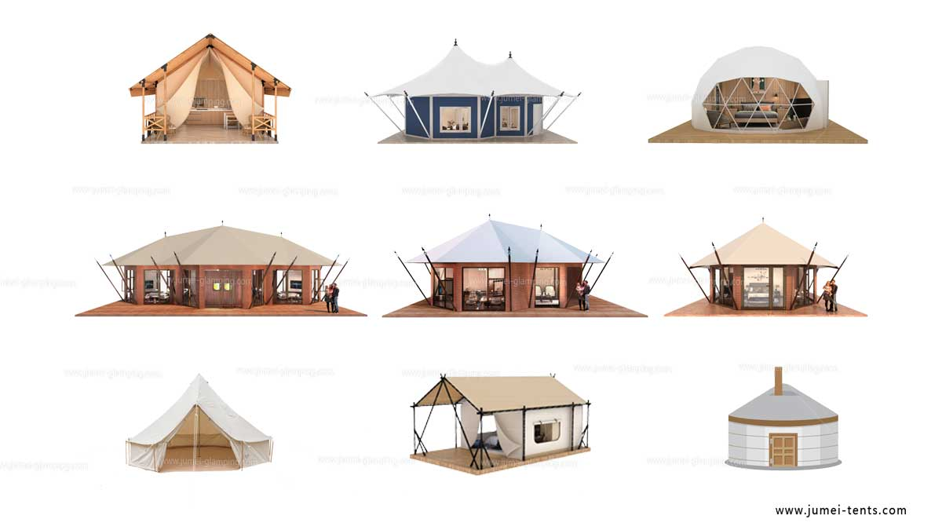
Sample tent designs:

Slide 15
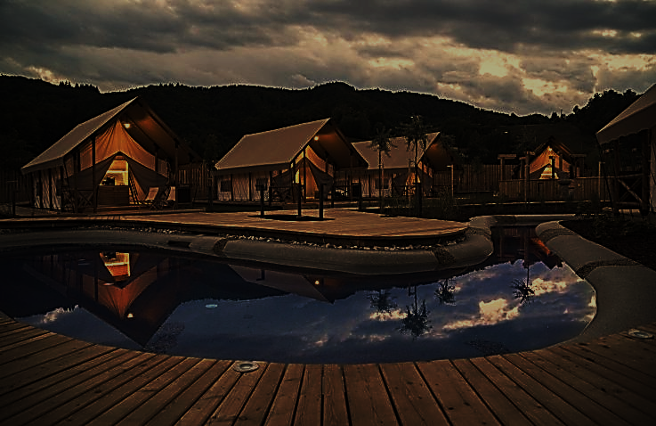
Singapore
10 Anson Road, 18- 11
International Plaza, Singapore 079903
Email: ds@5sensiconcept.com
Ph: +68 9800 2165
Web: www.5sensiconcept.com
Middle East
2405, HDS Tower, Jumeirah Lake Towers
Dubai, United Arab Emirates
Email: ag@5sensiconcept.com
Ph: +971 04 4534976
Glamping
Europe
264, Main Street
Mallieha, Malta
MLH 2317079903
Hospitality
Wellness
Lifestyle

Slide 16
Glamping
Thank You

